Slide 1
SCS3212 Machine Learning Algorithms & Programming
Part 3. Instance Based Learning
Peter Waiganjo Wagacha
2026

Slide 2
Instance based learning methods
Include the following:
Nearest Neighbor
Locally weighted regression
Case based reasoning (CBR)

Slide 3
Instance Based Learning
Key idea: just store all training examples <x_{i},f(x_{i})>
Nearest neighbour:
Given query instance x_{q}, first locate nearest training example x_{n}, then estimate f(x_{q})=f(x_{n})
k-nearest neighbour:
Given x_{q}, take vote among its k nearest neighbors (if discrete-valued target function)
Take mean of f values of k nearest neighbors (if real-valued) f(x_{q})=Σ f(x_{i}) /k
^
i=1
^
k
^
Note: f - value returned by algorithm

Slide 4
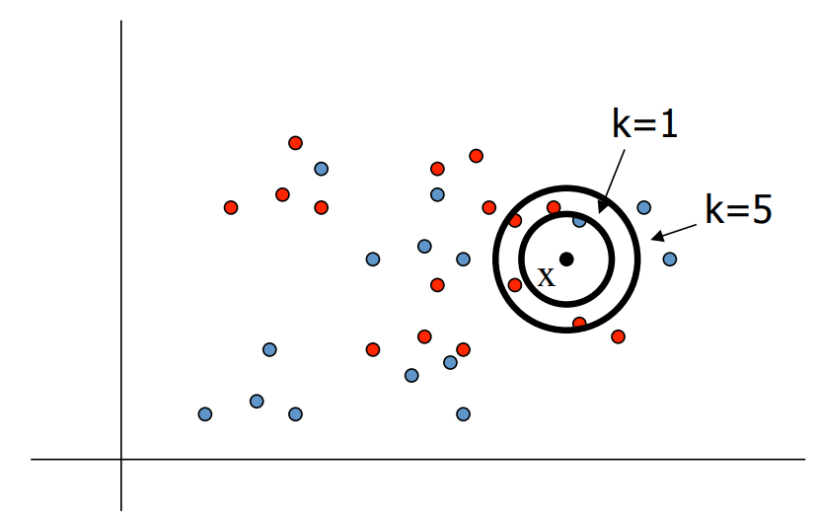
K-Nearest Neighbour
To classify a new input vector x, examine the k-closest nearest data points to x and assign the object to the most frequent occurring class

Slide 5
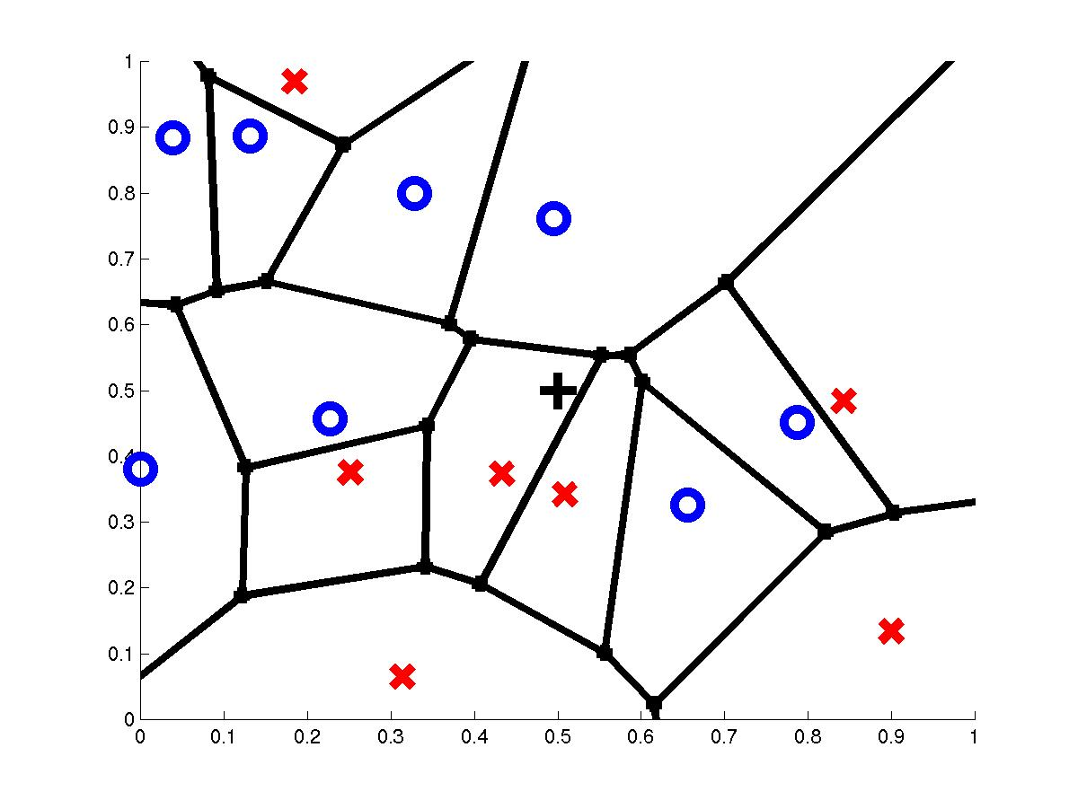
Voronoi Diagram
query point q_{f}
nearest neighbor q_{i}
Example: complex 2-class problem(x,o) using 2 attributes on x and y axis

Slide 6
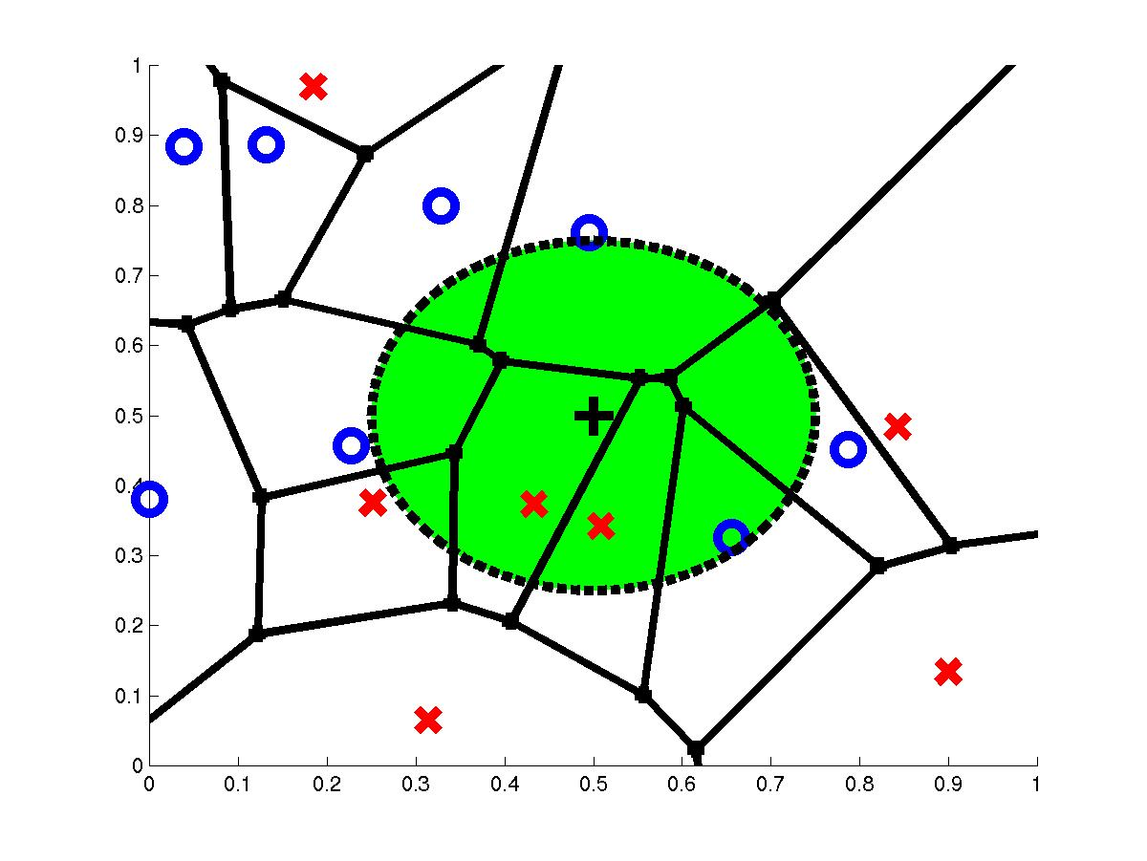
3-Nearest Neighbors
query point q_{f}
3 nearest neighbors
2x,1o

Slide 7
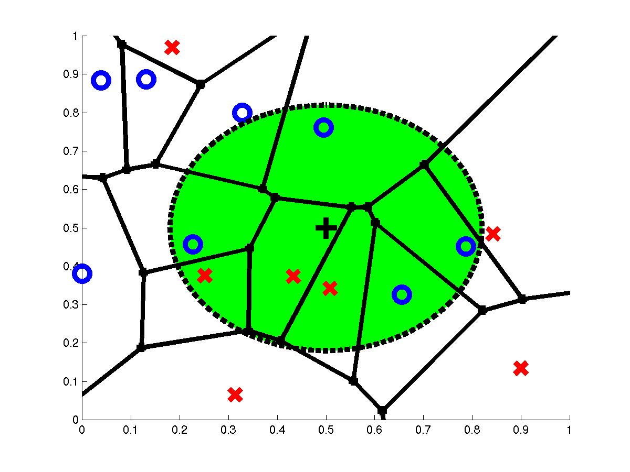
7-Nearest Neighbors
query point q_{f}
7 nearest neighbors
3x,4o

Slide 8
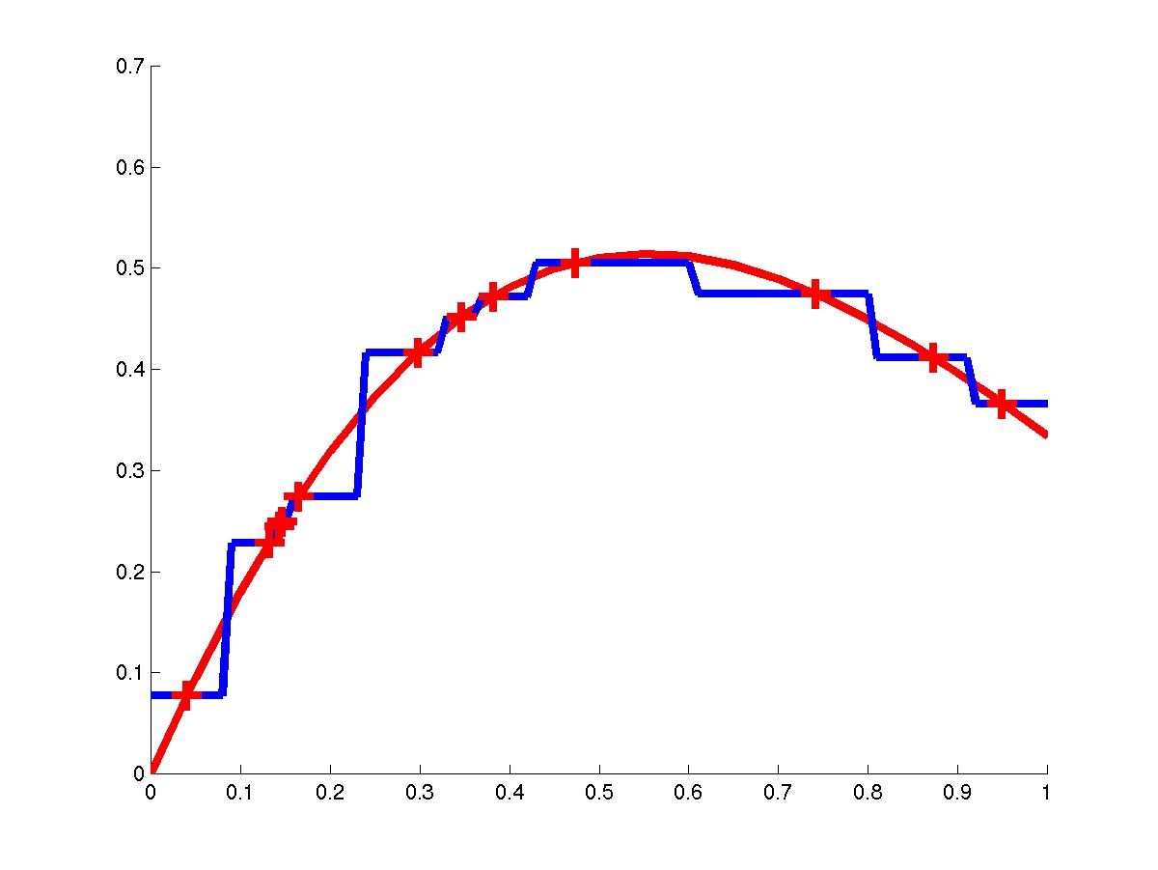
Nearest Neighbor (continuous)
1-nearest neighbor

Slide 9
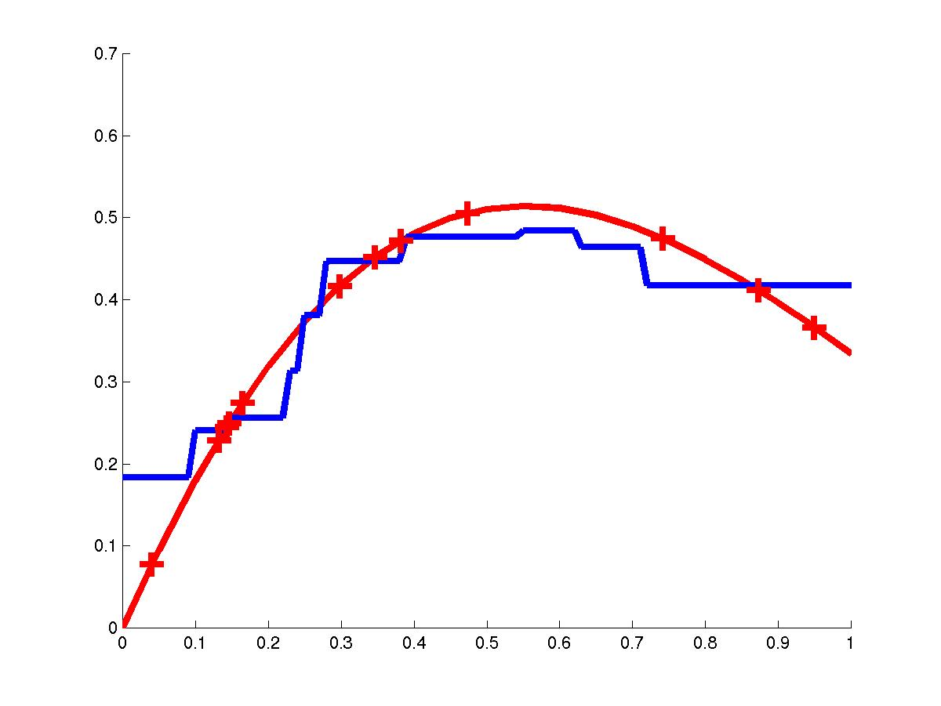
Nearest Neighbor (continuous)
3-nearest neighbor

Slide 10
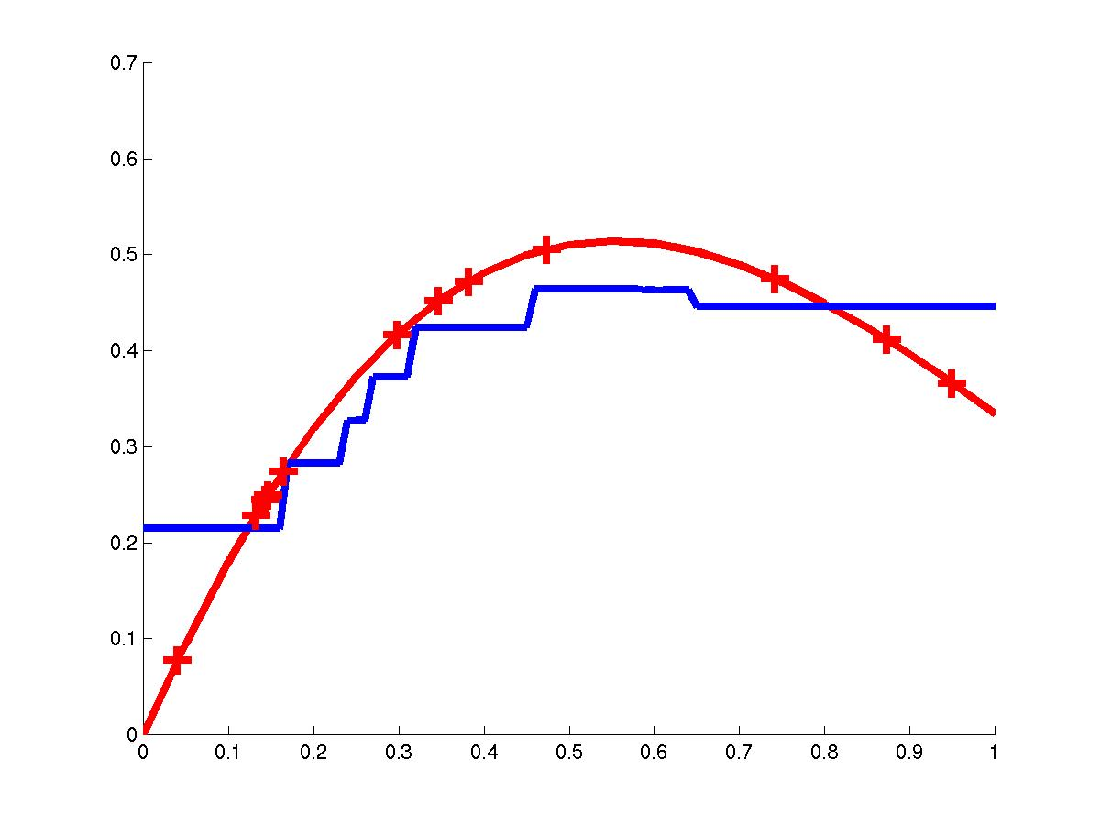
Nearest Neighbor (continuous)
5-nearest neighbor

Slide 11
Locally Weighted Regression
Regression means approximating a real-valued target function
Residual is the error
in approximating the target function
Kernel function is the function of distance that is used to determine the weight of each training example. In other words, the kernel function is the function K such that w_{i}=K(d(x_{i},x_{q}))

Slide 12
Distance Weighted k-NN
Give more weight to neighbors closer to the query point than the ones which are further away
f(x_{q}) = Σ w_{i} f(x_{i}) / Σw_{i}
where w_{i}=K(d(x_{q},x_{i}))
and d(x_{q},x_{i}) is the distance between x_{q} and x_{i}
Instead of only k-nearest neighbors use all training examples (Shepard’s method)
k
k
^
i=1
i=1

Slide 13
Distance Weighted Average
Weighting the data:
f(x_{q}) = Σ f(x_{i}) K(d(x_{i},xq))/ Σ K(d(x_{i},x_{q}))
Relevance of a data point (x_{i},f(x_{i})) is measured by calculating the distance d(x_{i},x_{q}) between the query x_{q} and the input vector x_{i}
Weighting the error criterion:
E(x_{q}) = Σ_{i} (f(x_{q})-f(x_{i}))² K(d(x_{i},xq))
the best estimate f(x_{q}) will minimize the cost E(q), therefore ∂E(q)/∂f(x_{q})=0
i
i
^
^
^

Slide 14
When to Consider Nearest Neighbors
Instances map to points in ℜ^{n} (where n-dimensional space)
Less than 20 attributes per instance
Lots of training data
Advantages:
Training is very fast
Learn complex target functions
Do not loose information
Disadvantages:
Slow at query time
Easily fooled by irrelevant attributes

Slide 15
Other Advantages
Easy to program
No optimization or training required
Classification and can be very good and can outperform more complex models

Slide 16
Issues with k-NEAREST NEIGHBOUR
Distance measure
Most common: Euclidean
Choosing k
Increasing k reduces variance, increases bias
For high dimensional space, problem is that the nearest neighbour may not be very close at all!
Memory based technique.
Must make a pass through the data for each classification. This can be prohibitive for large data sets.

Slide 17
Curse of Dimensionality
Imagine instances described by 20 attributes but only 2 are relevant to target function
Curse of dimensionality: nearest neighbor is easily misled when instance space is high-dimensional
One approach:
Stretch j-th axis by weight z_{j}, where z₁,…,z_{n} chosen to minimize prediction error
Use cross-validation to automatically choose weights z₁,…,z_{n}
Note setting zj to zero eliminates this dimension alltogether (feature subset selection)

Slide 18
k-NN Time Complexity
Suppose there are m instances and n features in the dataset
Nearest neighbor algorithm requires computing m distances
Each distance computation involves scanning through each feature value
Running time complexity is proportional to m X n

Slide 19
Q: How do we deal with Non-Numeric Data?
Feature values are not always numbers
Example
Boolean values: Yes or no, presence or absence of an attribute
Categories: Colours, educational attainment, gender
How do these values factor into the computation of distance?

Slide 20
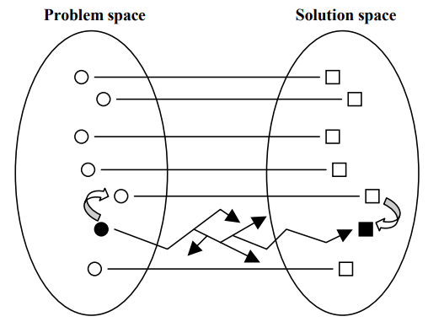
Case Based Reasoning
CBR is reasoning by remembering: previously solved problems (cases) are used to suggest solutions for novel but similar problems.
Once the currently encountered problem is described in terms of previously solved problems, the most similar solved problem can be found. The solution to this problem might be directly applicable to the current problem but, usually, some adaptation is required.

Slide 21
Lazy and Eager Learning
Lazy: wait for query before generalizing
k-nearest neighbors, weighted linear regression
Eager: generalize before seeing query
Radial basis function networks, decision trees, back-propagation
Eager learner must create global approximation
Lazy learner can create local approximations
If they use the same hypothesis space, lazy can represent more complex functions (H=linear functions)
Instance Based Learning is Lazy

